Slide 1
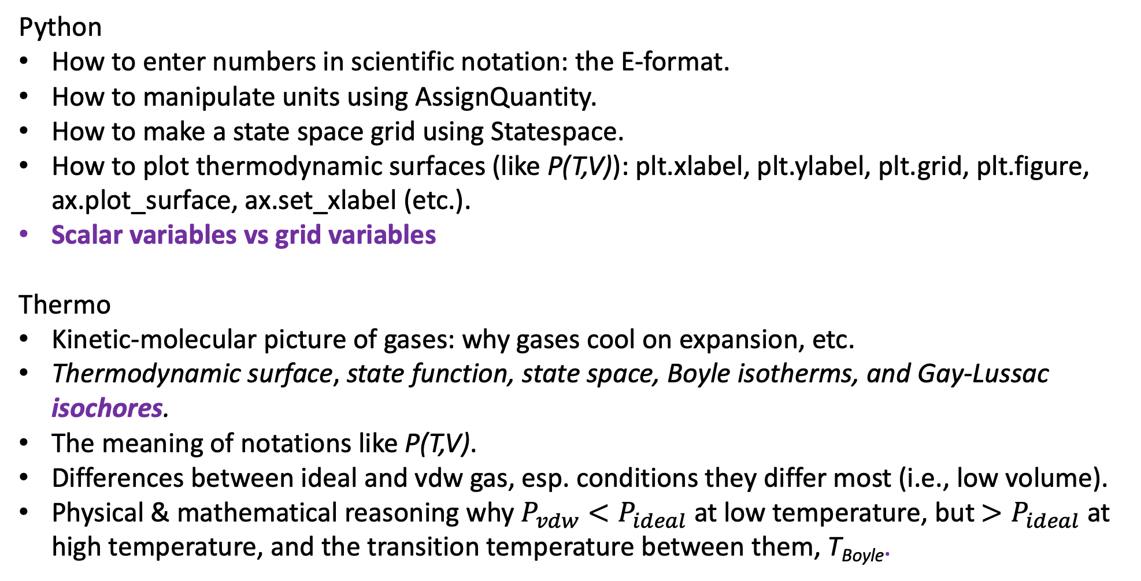
What we’ve learned (and going to learn today)…
Python
How to enter numbers in scientific notation: the E-format.
How to manipulate units using AssignQuantity.
How to make a state space grid using Statespace.
How to plot thermodynamic surfaces (like P(T,V)): plt.xlabel, plt.ylabel, plt.grid, plt.figure, ax.plot_surface, ax.set_xlabel (etc.).
Scalar variables vs grid variables
Thermo
Kinetic-molecular picture of gases: why gases cool on expansion, etc.
Thermodynamic surface, state function, state space, Boyle isotherms, and Gay-Lussac isochores.
The meaning of notations like P(T,V).
Differences between ideal and vdw gas, esp. conditions they differ most (i.e., low volume).
Physical & mathematical reasoning why $P_{vdw}<P_{ideal}$ at low temperature, but $>P_{ideal}$ at high temperature, and the transition temperature between them, T_{Boyle}.

Slide 2
Scalar variables vs grid variables
A scalar = a single number, like a volume or temperature
V
T
A grid = rows and columns of numbers (here, T,V state space)
In our Python code so far, we’ve generally used this naming convention
V, T, P to refer to scalars
Vgrid, Tgrid, Pgrid to refer to grids (often made by PL.Statespace)
(This naming convention is violated all the time, by the way, so you need to pay attention to how these are created to really know the difference.)

Slide 3
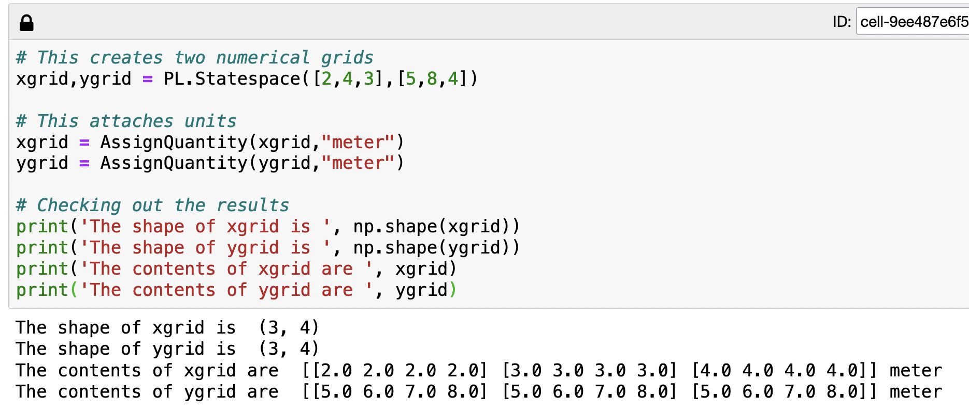
One way to make a gridded variable: use PL.Statespace
# of rows in the grid
# of columns in the grid

Slide 4
One way to make a gridded variable: use PL.Statespace
Range of values for each row
Range of values for each column

Slide 5
One way to make a gridded variable: use PL.Statespace

Slide 6
One way to make a gridded variable: use PL.Statespace

Slide 7
One way to make a gridded variable: use PL.Statespace

Slide 8
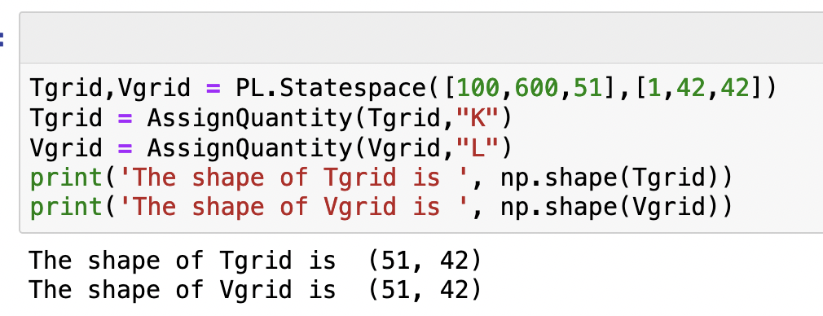
What would appear when we run this code?

Slide 9
What would appear when we run this code?

Slide 10
What would appear when we run this code?
42 volumes (columns)
V
T
51 temperatures (rows)

Slide 11
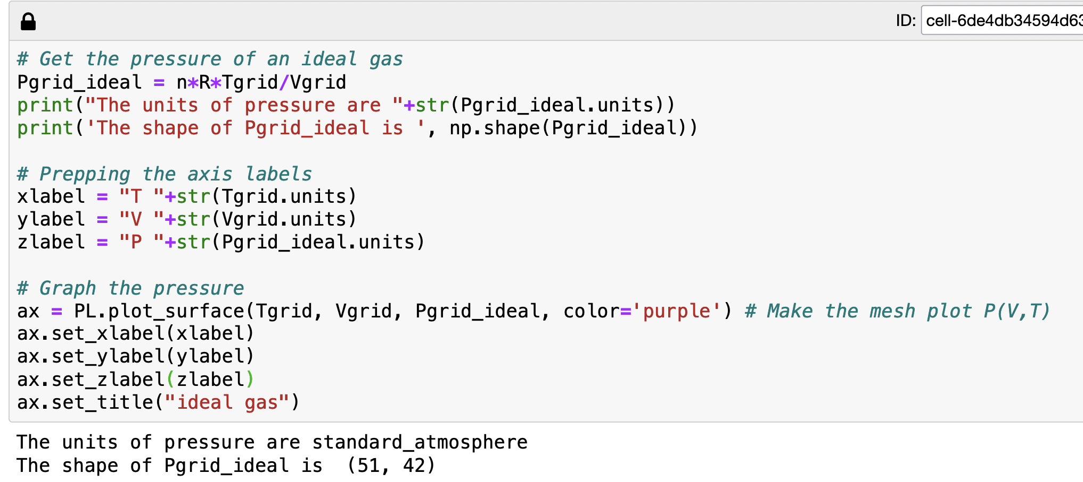
Another way to make a gridded variable: Calculate something from gridded variables (!)

Slide 12
Another way to make a gridded variable: Calculate something from gridded variables (!)
For every combination of volume and temperature, calculate a pressure.

Slide 13
Another way to make a gridded variable: Calculate something from gridded variables (!)
42 volumes
V
For every combination of volume and temperature, calculate a pressure.
T
51 temperatures

Slide 14
Another way to make a gridded variable: Calculate something from gridded variables (!)
42 volumes
V
For every combination of volume and temperature, calculate a pressure. So Pgrid_ideal is also a gridded variable!
T
51 temperatures

Slide 15
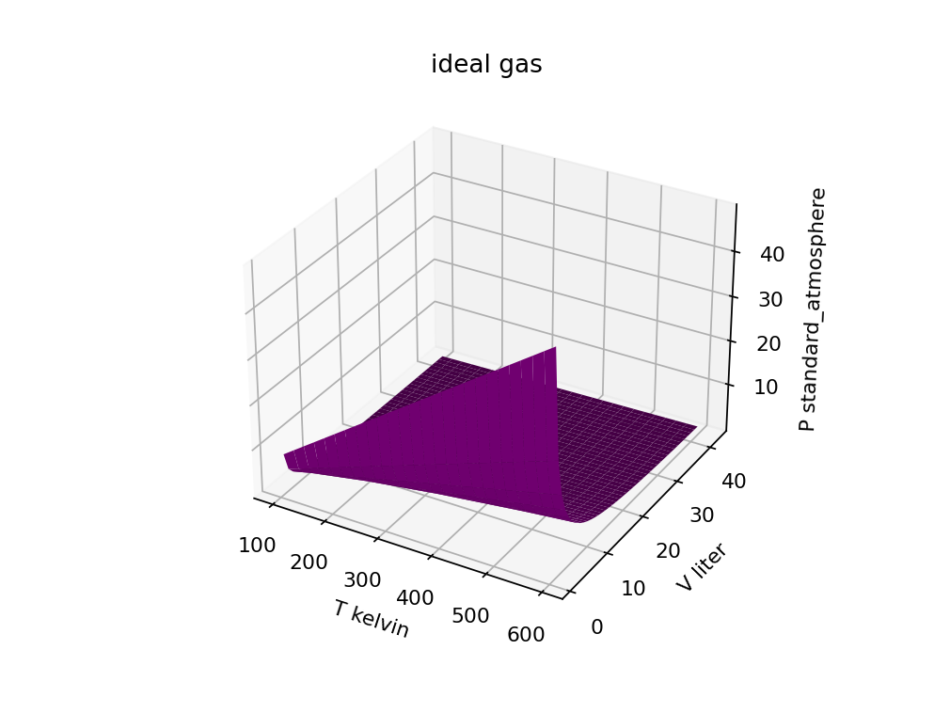
Visualizing a calculated gridded variable
42 volumes
51 temperatures

Slide 16
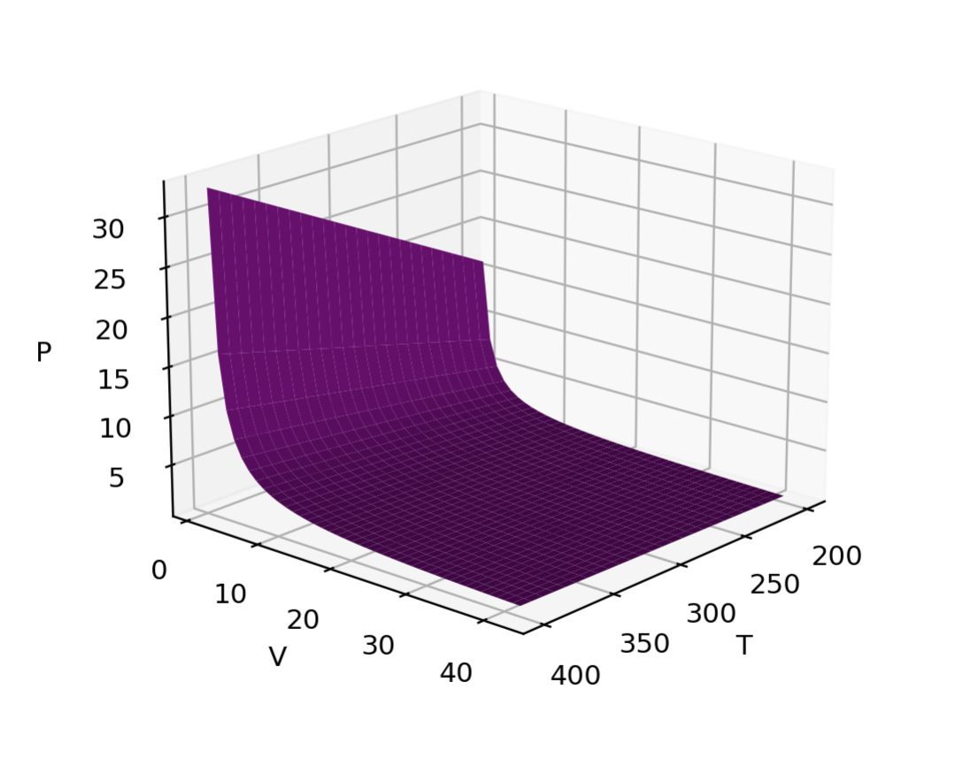
Isotherms and isochores
Isotherm = path of constant temperature
Isochore = path of constant volume

Slide 17
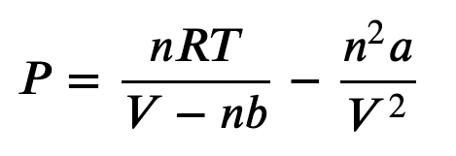

We talked about why we would expect a real gas (here, approximated as a van der Waals gas) might have higher or lower pressure than an ideal gas
Intermolecular forces
When “a” is big, intermolecular attraction (“stickiness”) is significant, and the pressure is smaller than ideal.
When “b” is big, intermolecular repulsion is significant, and the pressure is bigger than ideal.
Attractions => $P_{vdw}<P_{ideal}$
Repulsions => $P_{vdw}>P_{ideal}$

Slide 18
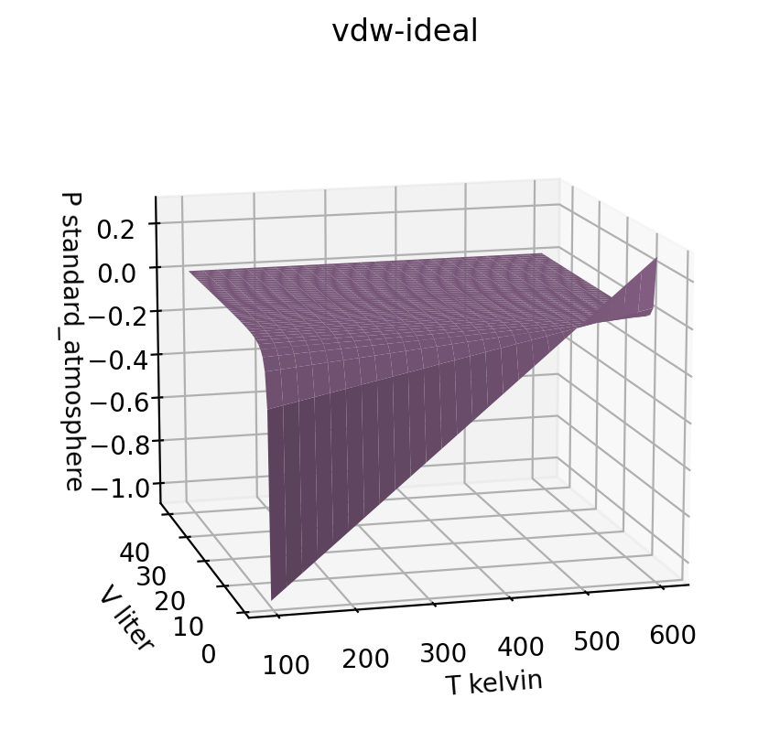
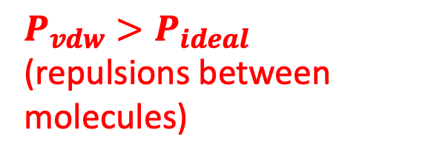
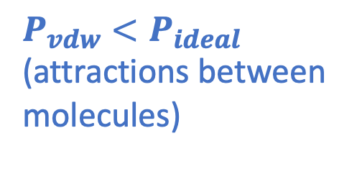
We found that Ar does both, depending on temperature (especially visible at small volumes)
$P_{vdw}>P_{ideal}$ (repulsions between molecules)
$P_{vdw}<P_{ideal}$ (attractions between molecules)

Slide 19
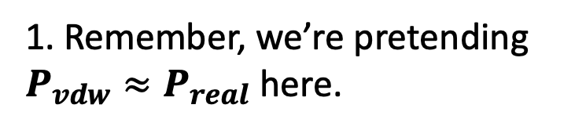
We found that Ar does both, depending on temperature (especially visible at small volumes)
$P_{vdw}>P_{ideal}$ (repulsions between molecules)
$P_{vdw}<P_{ideal}$ (attractions between molecules)
1. Remember, we’re pretending $P_{vdw}≈P_{real}$ here.

Slide 20
We found that Ar does both, depending on temperature (especially visible at small volumes)
$P_{vdw}>P_{ideal}$ (repulsions between molecules)
$P_{vdw}<P_{ideal}$ (attractions between molecules)
1. Remember, we’re pretending $P_{vdw}≈P_{real}$ here.
2. But what causes intermolecular attractions or repulsion in the first place?

Slide 21
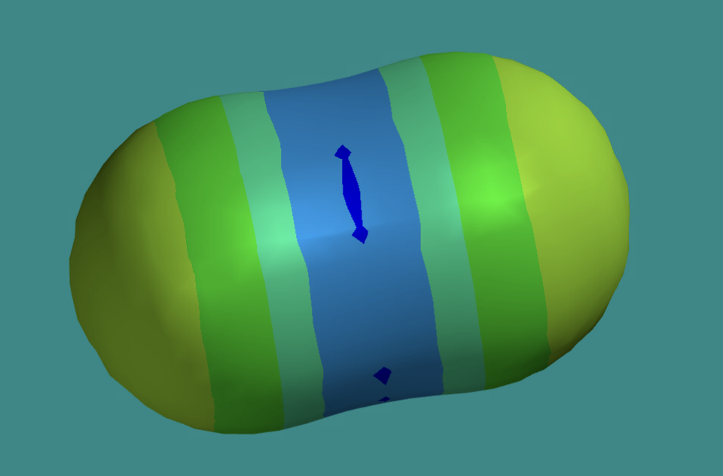
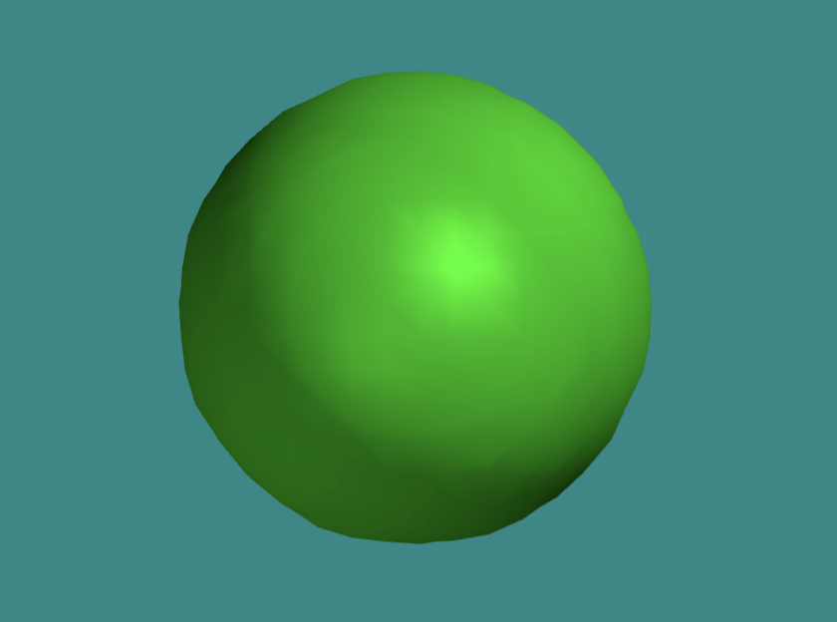
All molecules are slightly sticky
-
-
+
+
-
-

Slide 22
But CO₂ molecules have a charge imbalance that makes electrostatic attractions possible too
-
-
+
Electrostatic attraction not possible between Ar atoms.
Electrostatic attraction is possible between two CO₂ molecules when they’re lined up right.
+
-
-

Slide 23
Which would we expect to have more attractions, two CO₂ molecules or two Ar atoms?
-
-
+
Stickier!
Just stickiness
Electrostatic attraction and stickiness
+
-
-

Slide 24
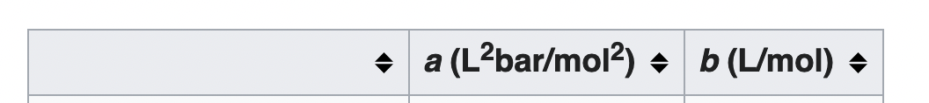
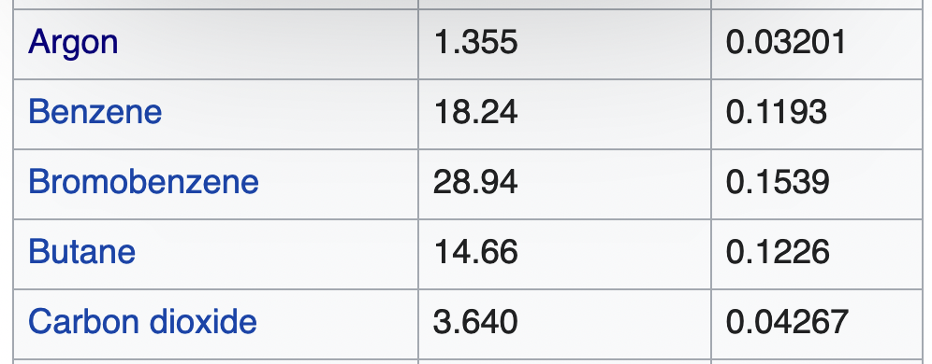
Which would we expect to have more attractions, two CO₂ molecules or two Ar atoms?
-
-
+
Stickier!
Just stickiness
Electrostatic attraction and stickiness
+
-
-

Slide 25
Which would we expect to have more attractions, two CO₂ molecules or two Ar atoms?
-
-
+
Stickier!
Just stickiness
Electrostatic attraction and stickiness
+
-
-
vdw “a” is bigger for CO₂ than for Ar

Slide 26
Which would we expect to have more attractions, two CO₂ molecules or two Ar atoms?
-
-
+
Stickier!
Just stickiness
Electrostatic attraction and stickiness
+
-
-
vdw “b” is bigger for CO₂ than for Ar too

Slide 27
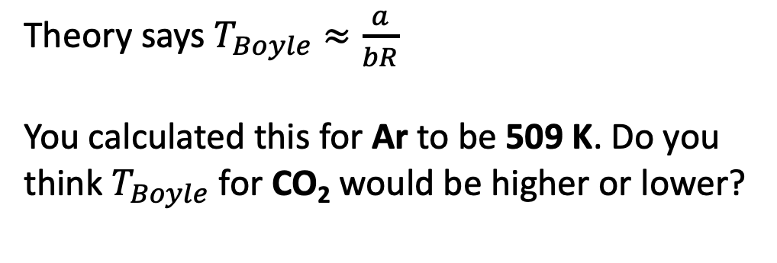
Predicting the Boyle temperature
Theory says $T_{Boyle}≈\frac{a}{bR}$
You calculated this for Ar to be 509 K. Do you think $T_{Boyle}$ for CO₂ would be higher or lower?
Ar
Ar gas

Slide 28
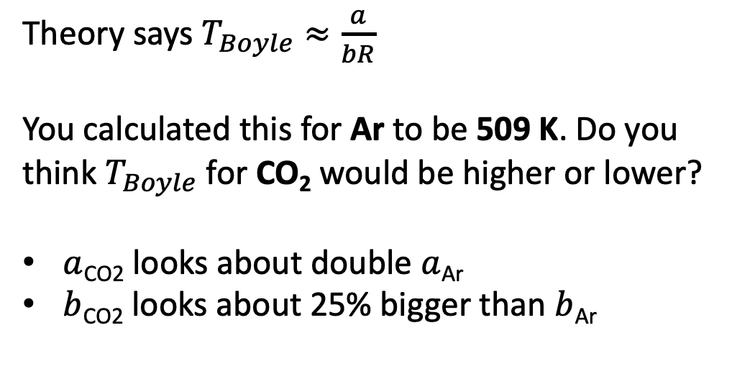
Predicting the Boyle temperature
Theory says $T_{Boyle}≈\frac{a}{bR}$
You calculated this for Ar to be 509 K. Do you think $T_{Boyle}$ for CO₂ would be higher or lower?
$a$_{CO2} looks about double $a$_{Ar}
$b$_{CO2} looks about 25% bigger than $b$_{Ar}
Ar
Ar gas

Slide 29
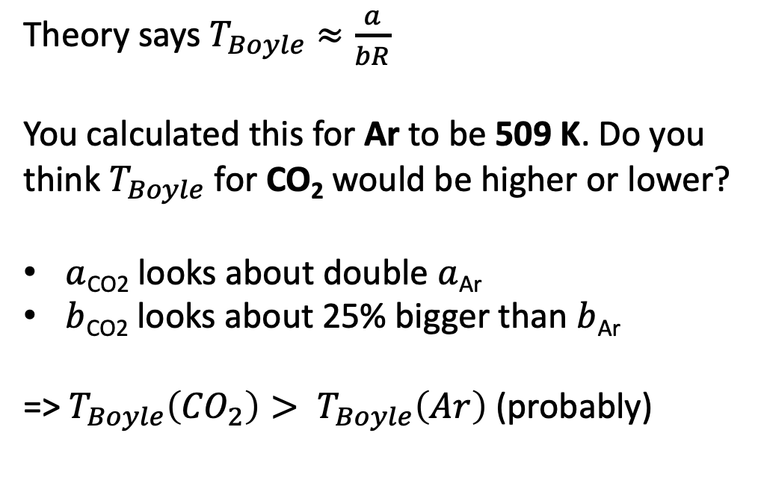
Predicting the Boyle temperature
Theory says $T_{Boyle}≈\frac{a}{bR}$
You calculated this for Ar to be 509 K. Do you think $T_{Boyle}$ for CO₂ would be higher or lower?
$a$_{CO2} looks about double $a$_{Ar}
$b$_{CO2} looks about 25% bigger than $b$_{Ar}
=> $T_{Boyle}\left({CO}_{2}\right)> T_{Boyle}\left(Ar\right)$ (probably)
Ar
Ar gas

Slide 30
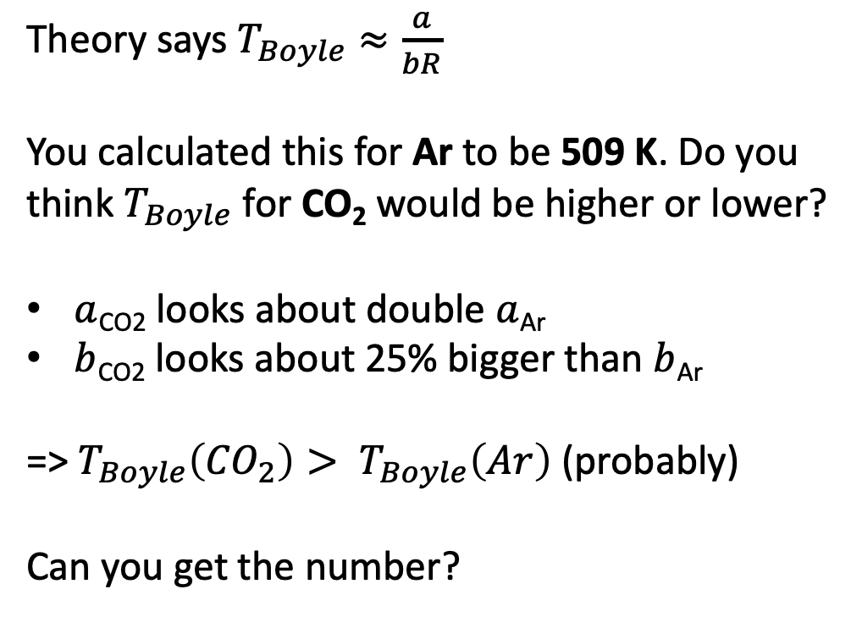
Predicting the Boyle temperature
Theory says $T_{Boyle}≈\frac{a}{bR}$
You calculated this for Ar to be 509 K. Do you think $T_{Boyle}$ for CO₂ would be higher or lower?
$a$_{CO2} looks about double $a$_{Ar}
$b$_{CO2} looks about 25% bigger than $b$_{Ar}
=> $T_{Boyle}\left({CO}_{2}\right)> T_{Boyle}\left(Ar\right)$ (probably)
Can you get the number?
Ar
Ar gas

Slide 31
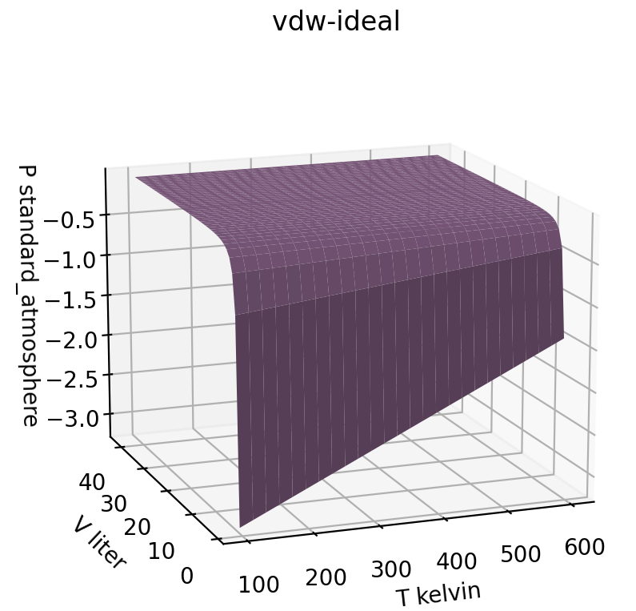
Predicting the Boyle temperature
Ar gas
CO₂ gas
> 1000 K

